Slide 1



淺談。陣列
1111資訊社

Slide 2
如果想要紀錄1個人的成績？
可以宣告1個整數來記錄成績。
int score = 100;

Slide 3
如果想要紀錄5個人的成績？
可以宣告5個整數來記錄成績。
int score1 = 100, score2 = 89, score3 = 74,
score4 = 70, score5 = 40;

Slide 4
如果想要紀錄100個人的成績？
可以宣告100個整數來記錄成績。
int score1 = 1, score2 = 4, score3 = 37,
score4 = 73, score5 = 3, score6 = 30,
score7 = 32, score8 = 35, score9 = 52,
score10 = 57, score11 = 48, score12 = 72,
score13 = 50, score14 = 59, score15 = 100,
score16 = 22, score17 = 55, score18 = 84,
score19 = 89, score20 = 34, score21 = 89,
score22 = 36, score23 = 90, score24 = 87,
score25 = 35, score26 = 82, score27 = 74,
score28 = 33, score29 = 15, score30 = 6,
score31 = 29, score32 = 11, score33 = 7, score34 = 21, score35 = 80, score36 = 0, score37 = 6, score38 = 81, score39 = 80, score40 = 44, score41 = 32, score42 = 3, score43 = 76, score44 = 56, score45 = 54, score46 = 26, score47 = 20, score48 = 62, score49 = 92, score50 = 7, score51 = 12, score52 = 89, score53 = 84, score54 = 38, score55 = 2, score56 = 50, score57 = 78, score58 = 5, score59 = 33, score60 = 76, score61 = 53, score62 = 32, score63 = 88, score64 = 51, score65 = 11, score66 = 81, score67 = 24, score68 = 7, score69 = 84, score70 = 0, score71 = 17, score72 = 67, score73 = 23, score74 = 9, score75 = 37, score76 = 75, score77 = 90, score78 = 60, score79 = 36, score80 = 45, score81 = 49, score82 = 73, score83 = 43, score84 = 27, score85 = 14, score86 = 66, score87 = 58, score88 = 6, score89 = 38, score90 = 7, score91 = 48, score92 = 78, score93 = 63, score94 = 1, score95 = 99, score96 = 47, score97 = 39, score98 = 16, score99 = 40, score100 = 20
以下省略…

Slide 5
如果想要紀錄100個人的成績？
可以宣告100個整數來記錄成績。
int score1 = 1, score2 = 4, score3 = 37,
score4 = 73, score5 = 3, score6 = 30,
score7 = 32, score8 = 35, score9 = 52,
score10 = 57, score11 = 48, score12 = 72,
score13 = 50, score14 = 59, score15 = 100,
score16 = 22, score17 = 55, score18 = 84,
score19 = 89, score20 = 34, score21 = 89,
score22 = 36, score23 = 90, score24 = 87,
score25 = 35, score26 = 82, score27 = 74,
score28 = 33, score29 = 15, score30 = 6,
score31 = 29, score32 = 11, score33 = 7, score34 = 21, score35 = 80, score36 = 0, score37 = 6, score38 = 81, score39 = 80, score40 = 44, score41 = 32, score42 = 3, score43 = 76, score44 = 56, score45 = 54, score46 = 26, score47 = 20, score48 = 62, score49 = 92, score50 = 7, score51 = 12, score52 = 89, score53 = 84, score54 = 38, score55 = 2, score56 = 50, score57 = 78, score58 = 5, score59 = 33, score60 = 76, score61 = 53, score62 = 32, score63 = 88, score64 = 51, score65 = 11, score66 = 81, score67 = 24, score68 = 7, score69 = 84, score70 = 0, score71 = 17, score72 = 67, score73 = 23, score74 = 9, score75 = 37, score76 = 75, score77 = 90, score78 = 60, score79 = 36, score80 = 45, score81 = 49, score82 = 73, score83 = 43, score84 = 27, score85 = 14, score86 = 66, score87 = 58, score88 = 6, score89 = 38, score90 = 7, score91 = 48, score92 = 78, score93 = 63, score94 = 1, score95 = 99, score96 = 47, score97 = 39, score98 = 16, score99 = 40, score100 = 20
這樣效率也太低了吧！
有沒有更高效的方法呢？

Slide 6
陣列 Array

Slide 7
陣列 Array
在計算機科學中，陣列資料結構（英語：array data structure），簡稱陣列（英語：Array），是由相同類型的元素（element）的集合所組成的資料結構，分配一塊連續的記憶體來儲存。利用元素的索引（index）可以計算出該元素對應的儲存位址。最簡單的資料結構是線性陣列，也稱為一維陣列。
Source: Wikipedia Array_(data_structure)

Slide 8
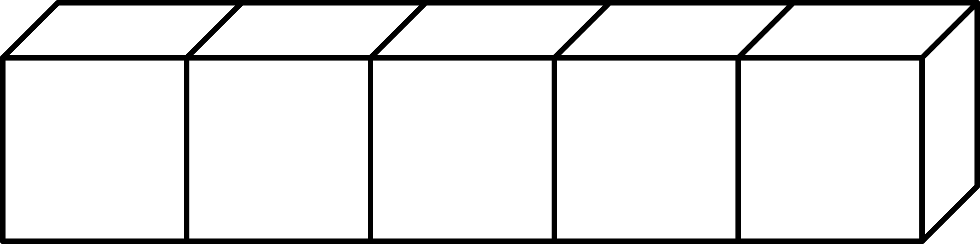
陣列 Array
可以將陣列想像成連續的盒子 (連續的記憶體空間)
以長度為5的一維陣列為例

Slide 9
陣列 Array
可以將陣列想像成連續的盒子 (連續的記憶體空間)
盒外有編號，稱為註標(index)
從0開始算
註標(index)
0
1
2
3
4
以長度為5的一維陣列為例

Slide 10
陣列 Array
可以將陣列想像成連續的盒子 (連續的記憶體空間)
盒外有編號，稱為註標(index)
盒內有資料
從0開始算
100
50
89
34
67
註標(index)
0
1
2
3
4
以長度為5的一維陣列為例

Slide 11
陣列 Array
在C++中可以這樣宣告：
類別名 名稱[大小];
例如：
int score[5];
float temperature[31];
bool isPassed[10];
string score[5];

Slide 12
陣列 Array
當陣列被宣告後，系統會在記憶體中找一塊連續的記憶體空間來存放陣列
宣告在區域變數的陣列，若沒有初始化，視編譯器而定，內部可能有「垃圾」(記憶體殘值)
4562
32
0
9831
3179
註標(index)
0
1
2
3
4
以長度為5的一維陣列為例

Slide 13
陣列 Array
在C++中可以這樣初始化：
類別名 名稱[大小(可填可不填)] = {元素1, 元素2, …, 元素n};
int score[] = {100, 89, 74, 70, 40};
編譯器會自動推導

Slide 14
陣列 Array
若 給定元素大小 < 陣列大小，則會自動填入該類別的預設值(0)
int score[5] = {100, 89};
自動填入 0
自動填入 0
自動填入 0
100
89
0
0
0
註標(index)
0
1
2
3
4

Slide 15
陣列 Array
若 給定元素大小 < 陣列大小，則會自動填入該類別的預設值(0)
int score[5] = {};
自動填入 0
0
0
0
0
0
註標(index)
0
1
2
3
4

Slide 16
陣列 Array
存取陣列的元素：
名稱[註標(index)]
例如：
score[2]
temperature[15]
isPassed[0]

Slide 17
陣列 Array
搭配for迴圈，存取陣列裡的元素
1 #include <iostream>
2 using namespace std;
3
4 int main()
5 {
6 int score[] = {100, 89, 74, 70, 40};
7
8 for (int i = 0; i < 5; i++){
9 cout << score[i] << " ";
10 }
11
12 return 0;
13 }
宣告一陣列
讓i從0跑到4
輸出score中第i個元素

Slide 18
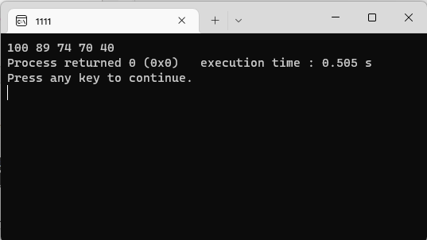
陣列 Array
搭配for迴圈，存取陣列裡的元素
1 #include <iostream>
2 using namespace std;
3
4 int main()
5 {
6 int score[] = {100, 89, 74, 70, 40};
7
8 for (int i = 0; i < 5; i++){
9 cout << score[i] << " ";
10 }
11
12 return 0;
13 }
宣告一陣列
讓i從0跑到4
輸出score中第i個元素

Slide 19
如果要記錄5個人7個科目的成績？
可以宣告5個陣列來記錄7個科目每個人的成績。
int score1[5] = {100, 90, 94, 43, 67};
int score2[5] = {45, 12, 0, 54, 67};
int score3[5] = {67, 1, 43, 87, 91};
int score4[5] = {50, 58, 32, 43, 0};
int score5[5] = {99, 90, 100, 57, 67};
int score6[5] = {98, 54, 18, 43, 67};
int score7[5] = {30, 90, 94, 37, 67};

Slide 20
如果要記錄5個人100個科目的成績？
可以宣告5個陣列來記錄100個科目每個人的成績。
int score1[5] = {100, 90, 94, 43, 67};
int score2[5] = {45, 12, 0, 54, 67};
int score3[5] = {67, 1, 43, 87, 91};
int score4[5] = {50, 58, 32, 43, 0};
int score5[5] = {99, 90, 100, 57, 67};
int score6[5] = {98, 54, 18, 43, 67};
int score7[5] = {30, 90, 94, 37, 67};
int score8[5] = {30, 90, 94, 37, 67};
int score9[5] = {30, 90, 94, 37, 67};
以下省略…

Slide 21
如果要記錄5個人100個科目的成績？
可以宣告5個陣列來記錄100個科目每個人的成績。
int score1[5] = {100, 90, 94, 43, 67};
int score2[5] = {45, 12, 0, 54, 67};
int score3[5] = {67, 1, 43, 87, 91};
int score4[5] = {50, 58, 32, 43, 0};
int score5[5] = {99, 90, 100, 57, 67};
int score6[5] = {98, 54, 18, 43, 67};
int score7[5] = {30, 90, 94, 37, 67};
int score8[5] = {30, 90, 94, 37, 67};
int score9[5] = {30, 90, 94, 37, 67};
這樣效率也太低了吧！
有沒有更高效的方法呢？

Slide 22
多維陣列

Slide 23
多維陣列
只有1個註標的陣列為一維陣列，含有2個註標的陣列為二維陣列，含有3個註標的陣列為三維陣列，依此類推。
當註標多餘1時，我們稱該陣列為多維陣列。

Slide 24
如果要記錄5個人7個科目的成績？
可以宣告1個二維陣列來記錄7個科目每個人的成績。
int score[5][7] = {{100, 90, 94, 43, 67, 45, 12},
{67, 1, 43, 87, 0, 54, 67},
{67, 1, 43, 87, 91, 50, 58},
{50, 58, 32, 43, 0, 90, 100},
{99, 90, 100, 57, 67, 54, 18}};
5列7欄

Slide 25
如果要記錄5個人7個科目的成績？
int score[5][7] = {{100, 90, 94, 43, 67, 45, 12},
{67, 1, 43, 87, 0, 54, 67},
{67, 1, 43, 87, 91, 50, 58},
{50, 58, 32, 43, 0, 90, 100},
{99, 90, 100, 57, 67, 54, 18}};
score[3][4] <-第3個人第4科目的成績
score[0][6] <-第0個人第6科目的成績
score[1][0] <-第1個人第0科目的成績
5列7欄

Slide 26
多維陣列
搭配for迴圈，存取陣列裡的元素
讓i從0跑到4
讓j從0跑到6
1 #include <iostream>
2 using namespace std;
3
4 int main()
5 {
6 int score[5][7] = {{100, 90, 94, 43, 67, 45, 12},
7 {67, 1, 43, 87, 0, 54, 67},
8 {67, 1, 43, 87, 91, 50, 58},
9 {50, 58, 32, 43, 0, 90, 100},
10 {99, 90, 100, 57, 67, 54, 18}};
11
12 for (int i = 0; i < 5; i++){
13 for (int j = 0; j < 7; j++){
14 cout << score[i][j] << "\t";
15 }
16 cout << "\n";
17 }
18
19 return 0;
20 }
5列7欄，
第一格註標值代表人，第二格註標值代表科目
輸出score中第i個元素的第j個元素
宣告一陣列

Slide 27
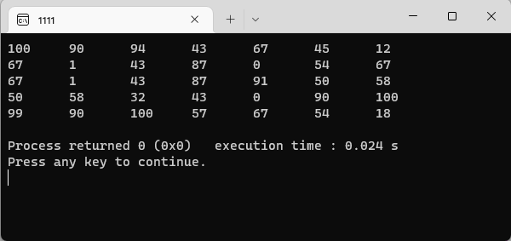
多維陣列
搭配for迴圈，存取陣列裡的元素
讓i從0跑到4
讓j從0跑到6
1 #include <iostream>
2 using namespace std;
3
4 int main()
5 {
6 int score[5][7] = {{100, 90, 94, 43, 67, 45, 12},
7 {67, 1, 43, 87, 0, 54, 67},
8 {67, 1, 43, 87, 91, 50, 58},
9 {50, 58, 32, 43, 0, 90, 100},
10 {99, 90, 100, 57, 67, 54, 18}};
11
12 for (int i = 0; i < 5; i++){
13 for (int j = 0; j < 7; j++){
14 cout << score[i][j] << "\t";
15 }
16 cout << "\n";
17 }
18
19 return 0;
20 }
5列7欄，
第一格註標值代表人，第二格註標值代表科目
輸出score中第i個元素的第j個元素
宣告一陣列

